Slide 1
Inducing Target-Specific Latent Structures for Aspect Sentiment Classification
汇报人：Gu Tang
时间：2020.11.27
Conference：EMNLP_2020
Github: https://github.com/CCSoleil/latent_graph_atsc

Slide 2
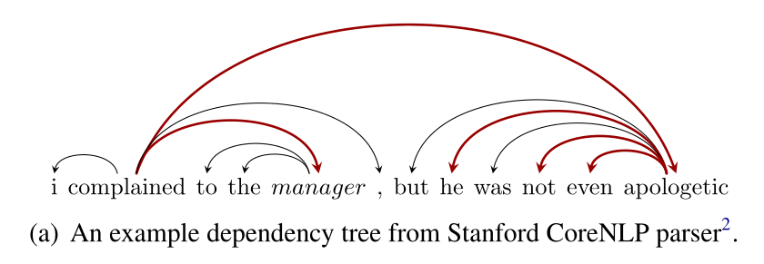
Motivations
For a sentence, its dependency syntactic structure may be very complicated. The key of GCN lies in the topology and its aggregation method. Our syntax dependency tree may itself have limitations in the syntactic analysis of complex sentences. GCN also exhibits complex topological structures. Certain limitations

Slide 3
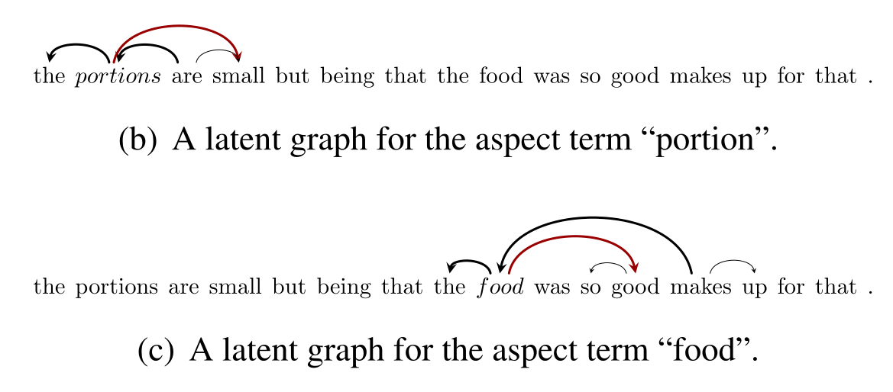
Motivations
But for an object, the dependency structure between it and the context may be very simple, and it also has a certain degree of locality. Therefore, the article attempts to use an automatic form to learn the underlying structure that depends on the current object.

Slide 4
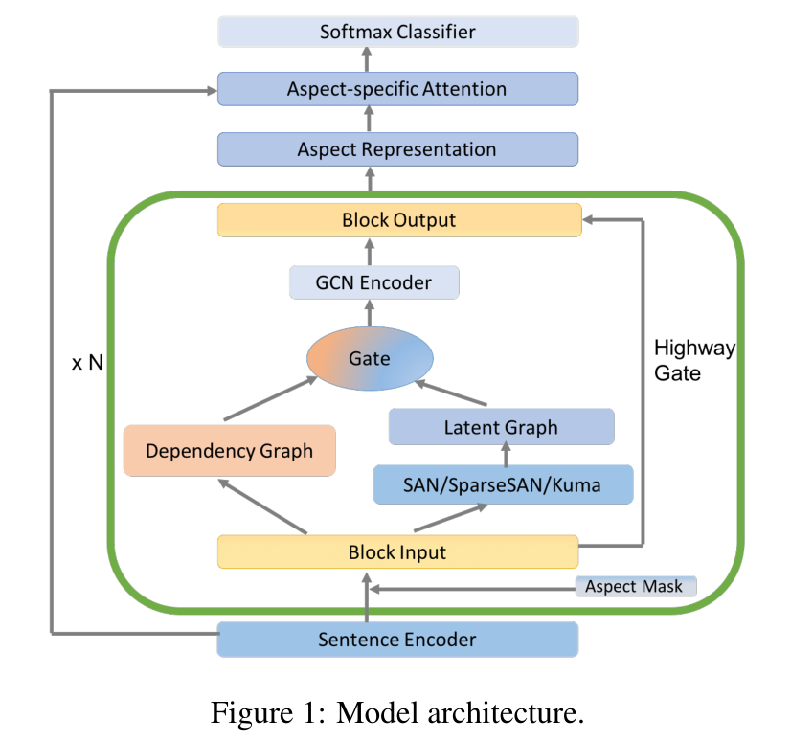
Model Architecture

Slide 5
Model Architecture
Glove_300d---->BiLSTM/base-Bert

Slide 6
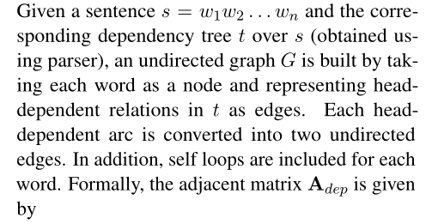
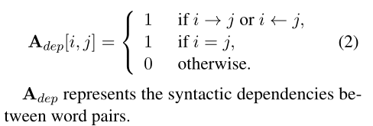
CoSan Prepare-data

Slide 7
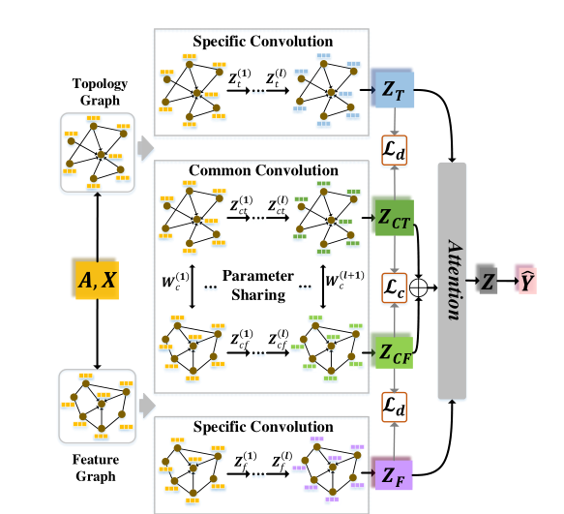
model

Slide 8
model
2008_Graphical Models, Exponential Families, and
Variational Inference

Slide 9
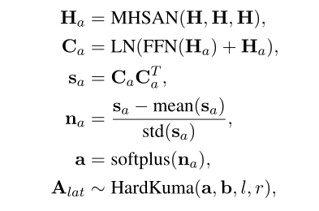
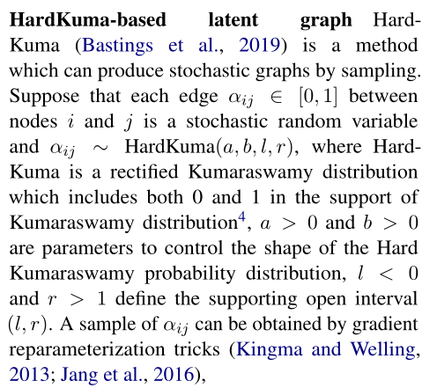
model

Slide 10
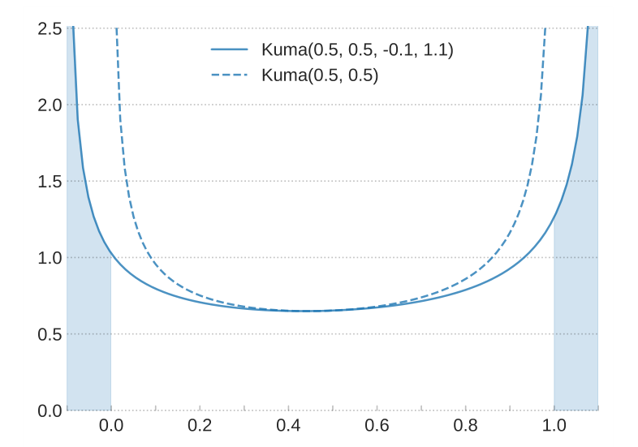
model
2019_Interpretable Neural Predictions with Differentiable Binary Variables

Slide 11
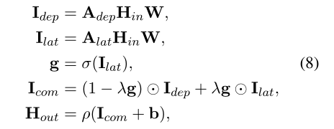
model
Gatecombine

Slide 12
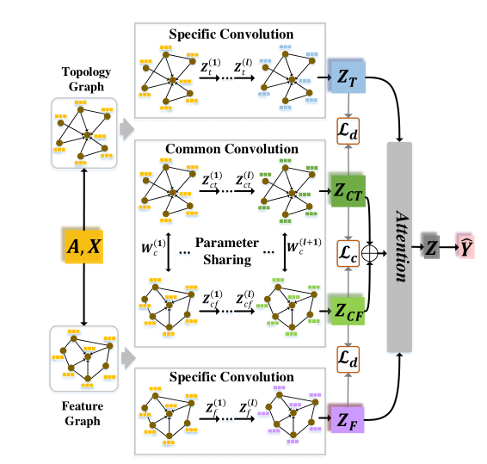
model

Slide 13
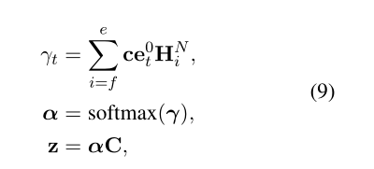
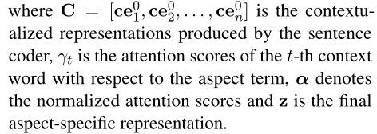
model

Slide 14
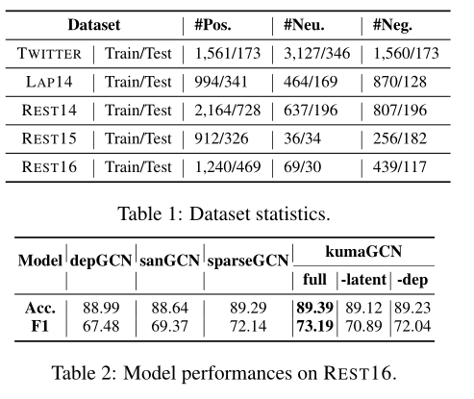
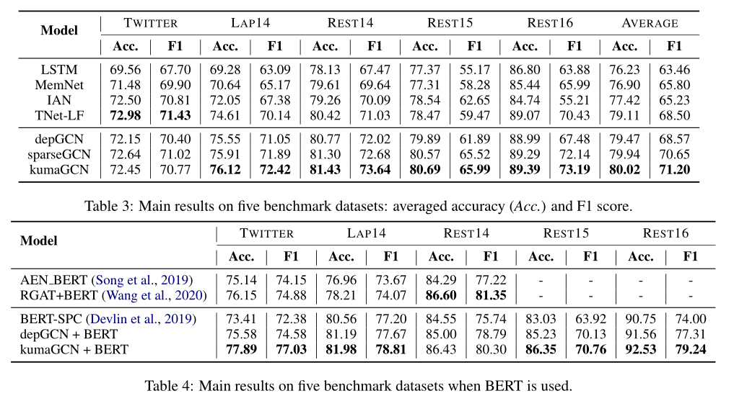
Experiment

Slide 15
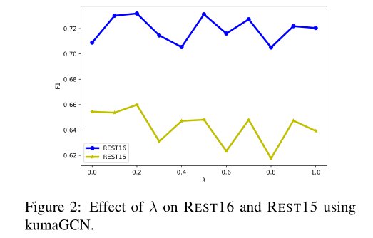
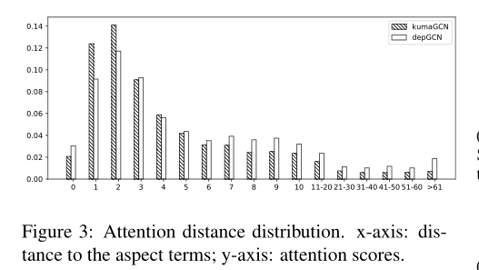
Experiment

Slide 16
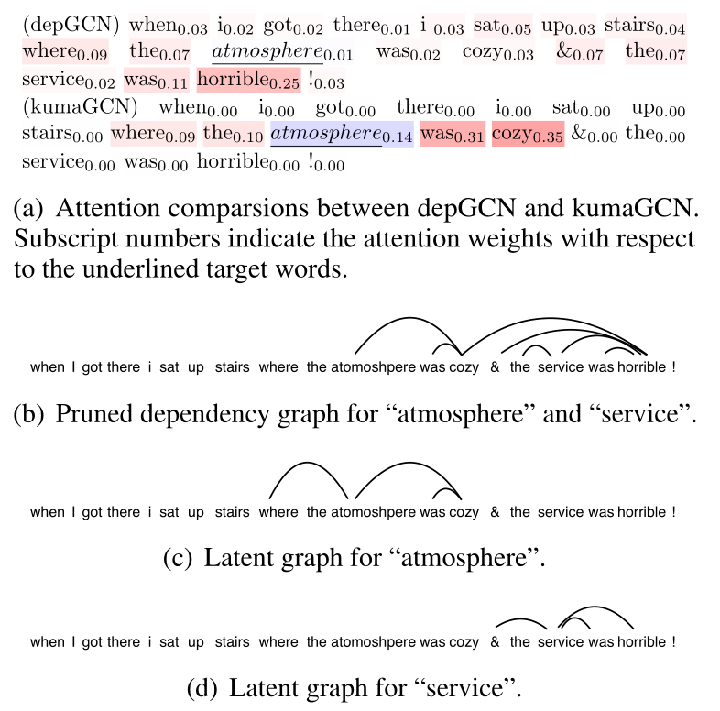
Experiment-case study

Slide 17
THANGKS!

